Slide 1
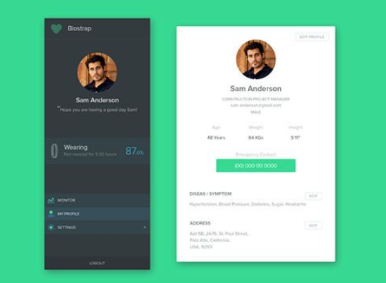
Colors: RGB
55, 216, 146
51, 59, 62
166, 167, 166
255, 255, 255
Colors: HEX
#37d892
#333b3e
#a6a7a6
#ffffff

